Slide 1
BJT-AC Analysis

Slide 2
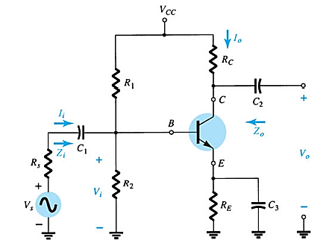
AC equivalent of Transistor Networks

Slide 3
AC equivalent of Transistor Networks
Setting all dc sources to zero and replacing them by a short-circuit equivalent
Replacing all capacitors by a short-circuit equivalent
Removing all elements bypassed by the short-circuit equivalents introduced by steps 1 and 2
Redrawing the network in a more convenient and logical form

Slide 4
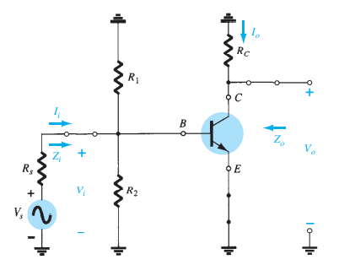
AC equivalent of Transistor Networks

Slide 5
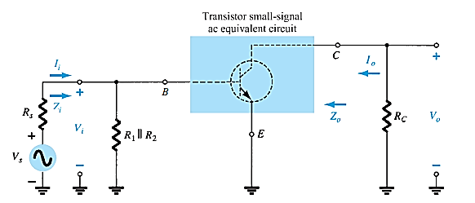
AC equivalent of Transistor Networks
?

Slide 6
BJT Transistor Modeling
A model is an equivalent circuit that represents the AC characteristics of the transistor.
A model uses circuit elements that approximate the behavior of the transistor.
There are two models commonly used in small signal AC analysis of a transistor:
r_{e} model
Hybrid equivalent model

Slide 7
The r_{e} Transistor Modeling
BJTs are basically current-controlled devices; therefore the r_{e} model uses a diode and a current source to duplicate the behavior of the transistor
The ac resistance of a diode can be determined by the equation r_{ac} = 26 mV/I_{D}, where I_{D} is the dc current through the diode at the Q (quiescent) point
One disadvantage to this model is its sensitivity to the DC level. This model is designed for specific circuit conditions

Slide 8
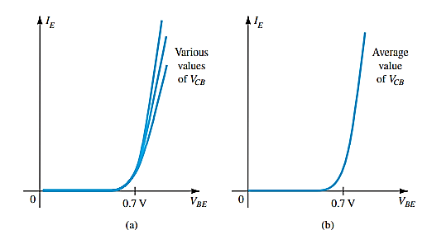
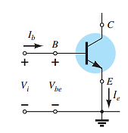
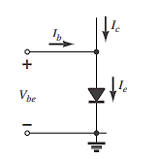
The r_{e} Transistor Modeling
For the equivalent circuit, therefore, the input side is simply a single diode with a current I_{e} ,

Slide 9
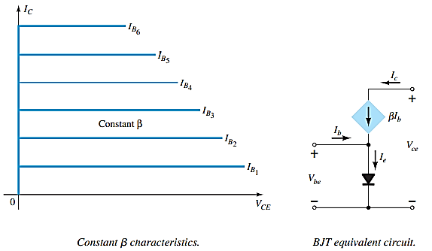
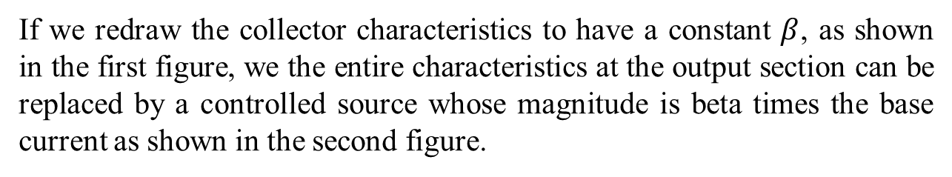
The r_{e} Transistor Modeling
If we redraw the collector characteristics to have a constant $β$, as shown in the first figure, we the entire characteristics at the output section can be replaced by a controlled source whose magnitude is beta times the base current as shown in the second figure.

Slide 10
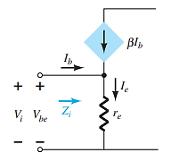
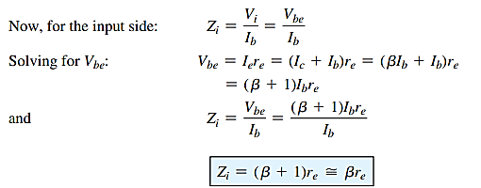
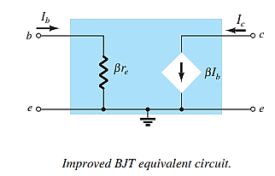
The r_{e} Transistor Modeling

Slide 11
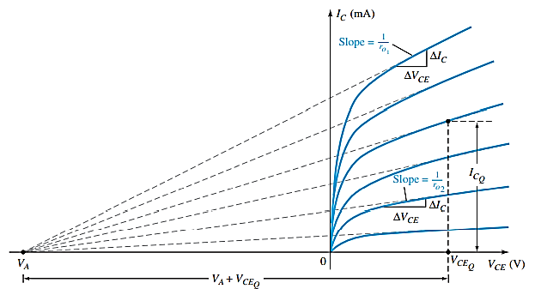

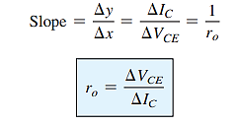
Early Voltage

Slide 12
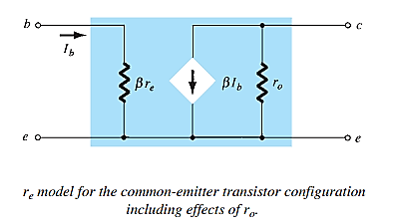
Early Voltage

Slide 13
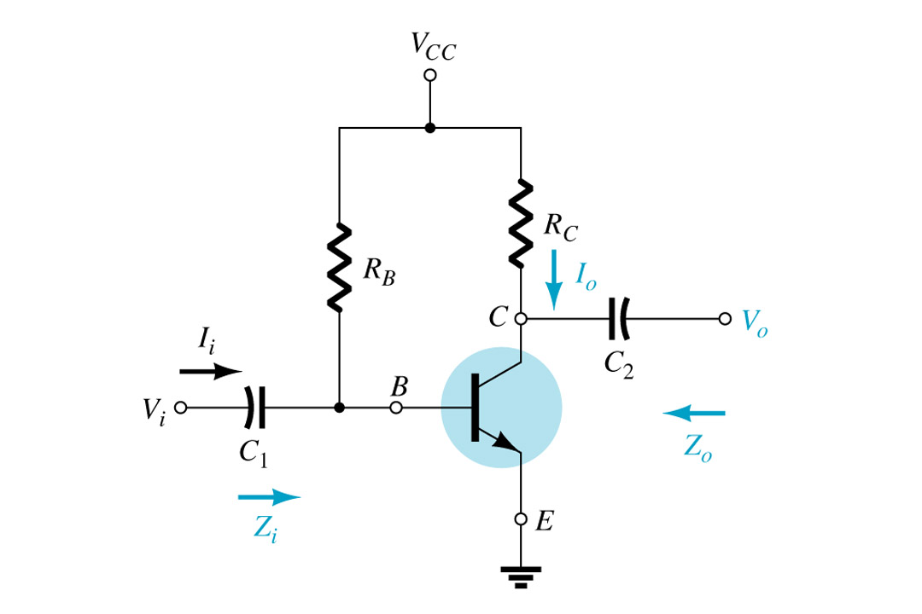
Common-Emitter (CE) Fixed-Bias Configuration
The input (V_{i}) is applied to the base and the output (V_{o}) is from the collector.
The Common-Emitter is characterized as having high input impedance and low output impedance with a high voltage and current gain.

Slide 14
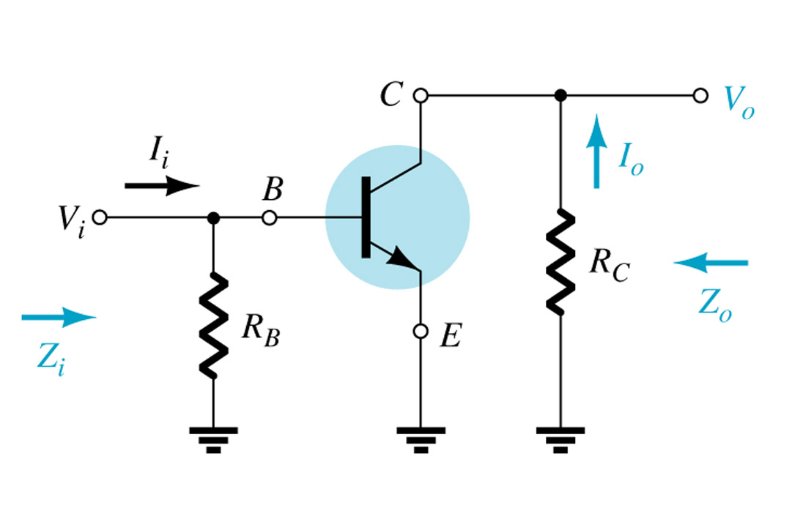
Removing DC effects of V_{CC} and Capacitors

Slide 15
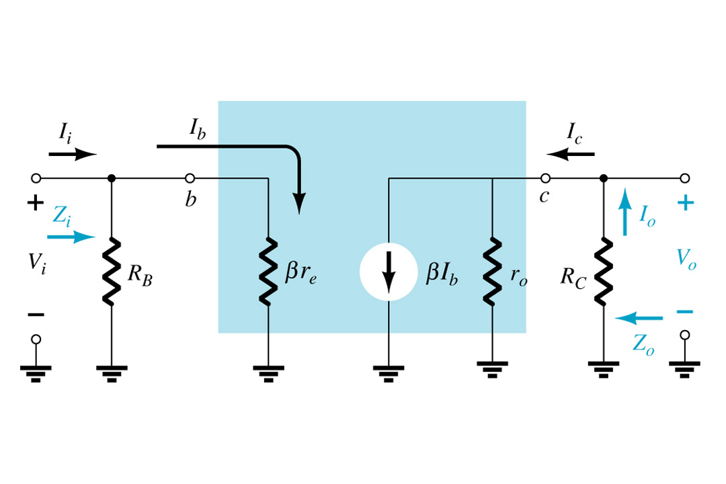

r_{e} Model
Determine β, re, and ro:
β and r_{o}: look in the specification sheet for the transistor or test the transistor using
a curve tracer.
r_{e}: calculate re using dc analysis:
$$re=\frac{\text{25}\text{mV}}{IE}$$

Slide 16
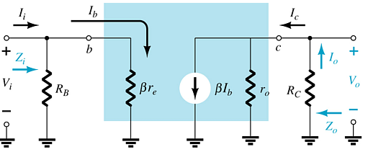
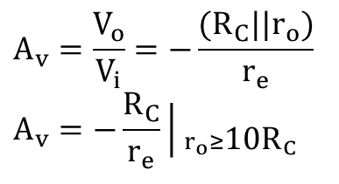
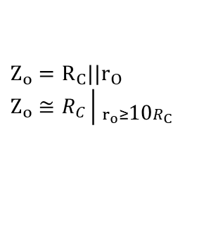
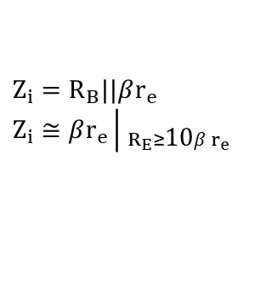

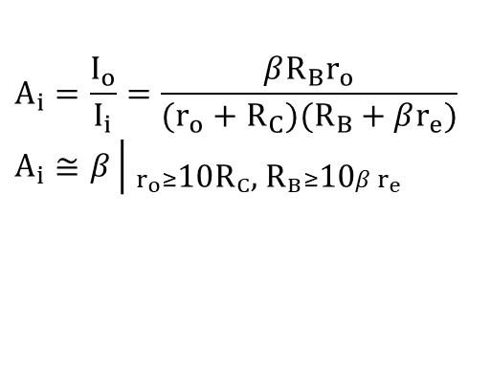
Common-Emitter Fixed-Bias Calculations
Input impedance:
$$Z_{i}=R_{B}||βr_{e} \\ Z_{i}≅βr_{e}\left| _{R_{E}≥\text{10}βr_{e}}\right.$$
Output impedance:
$$Z_{o}=R_{C}||r_{O} \\ Z_{o}≅R_{C}\left| _{r_{o}≥\text{10}R_{C}}\right.$$
Voltage gain:
Current gain:
$$A_{v}=\frac{V_{o}}{V_{i}}=−\frac{(R_{C}||r_{o})}{r_{e}} \\ A_{v}=−\frac{R_{C}}{r_{e}}\left| _{r_{o}≥\text{10}{\text{R}}_{C}}\right.$$
$$A_{i}=\frac{I_{o}}{I_{i}}=\frac{βR_{B}r_{o}}{(r_{o}+R_{C})(R_{B}+βr_{e})} \\ A_{i}≅β\left| _{r_{o}≥\text{10}{\text{R}}_{C}\text{, }{\text{R}}_{B}≥\text{10}βr_{e}}\right.$$
Current gain from voltage gain:
$$A_{i}=−A_{v}\frac{Z_{i}}{R_{C}}$$

Slide 17
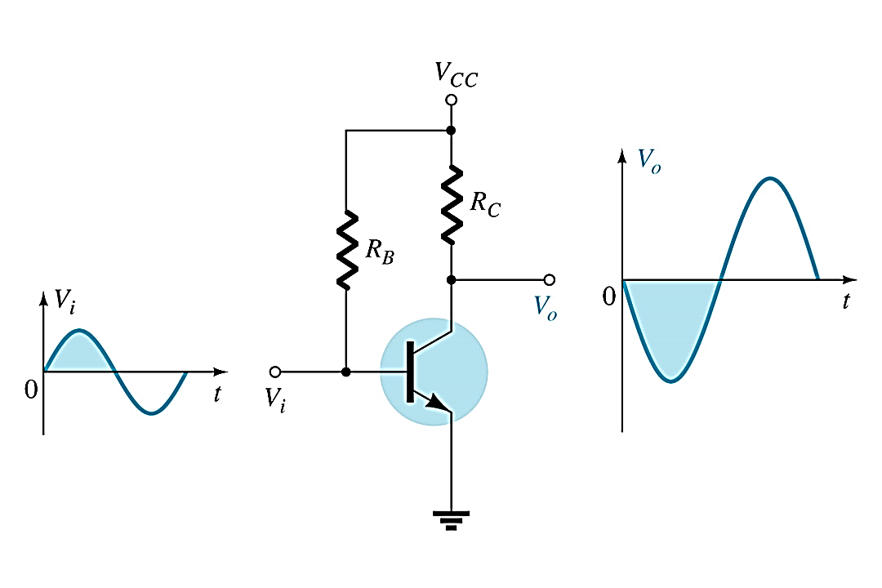
Phase Relationship
The phase relationship between input and output is 180 degrees. The negative sign used in the voltage gain formulas indicates the inversion.

Slide 18
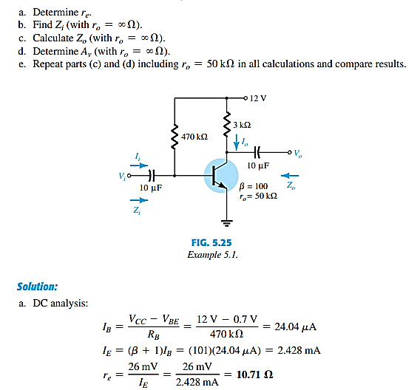

Slide 19
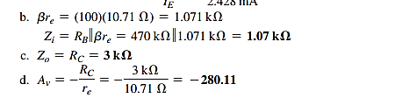

Slide 20
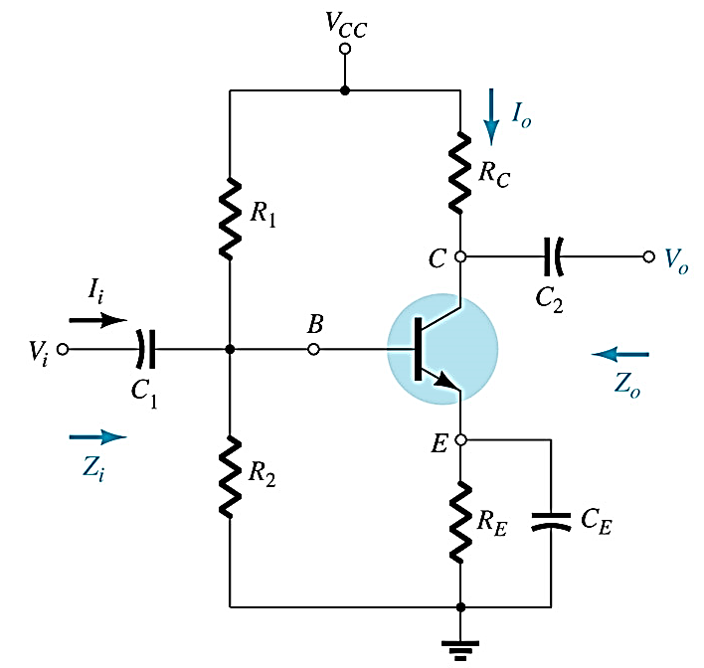
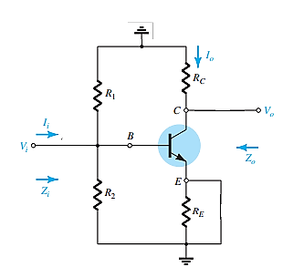
CE – Voltage-Divider Bias Configuration

Slide 21
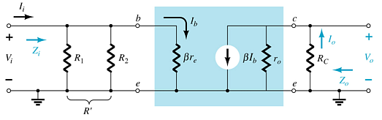
CE – Voltage-Divider Bias Configuration
r_{e} model requires you to determine β, r_{e}, and r_{o}.

Slide 22
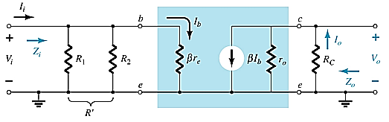
CE – Voltage-Divider Bias Configuration
Input impedance:
Output impedance:
Current gain:
Voltage gain:
Current gain from voltage gain:

Slide 23
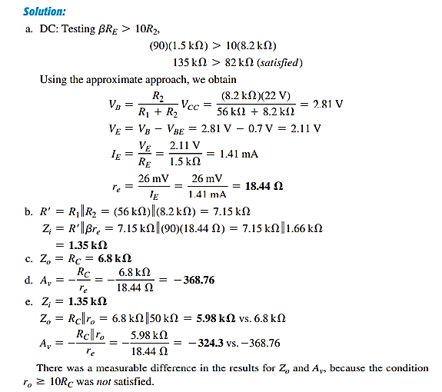
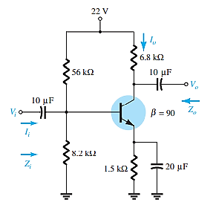
CE – Voltage-Divider Bias Configuration
For the following network, determine: a) r_{e,} b) Z_{i} c) Z_{o} (ro =$∞$). d) A_{v} (ro = $∞$).
e) The parameters of parts (ii) through (iv) if ro = 50 kΩ and compare results.

Slide 24
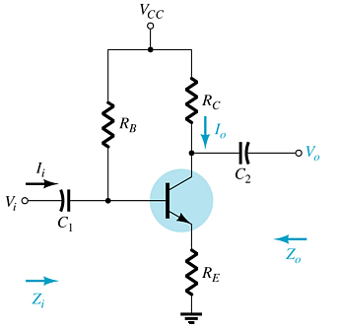
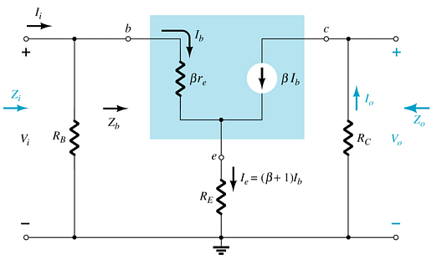
Common-Emitter Emitter-Bias Configuration

Slide 25
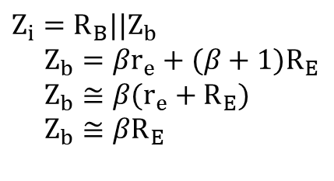

Impedance Calculations
Input impedance:
$$Z_{i}=R_{B}||Z_{b} \\ Z_{b}=βr_{e}+(β+1)R_{E} \\ Z_{b}≅β(r_{e}+R_{E}) \\ Z_{b}≅βR_{E}$$
Output impedance:
$$Z_{o}=R_{C}$$

Slide 26
Gain Calculations
Voltage gain:
Current gain:
Current gain from voltage gain:

Slide 27
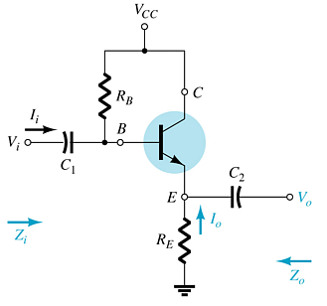
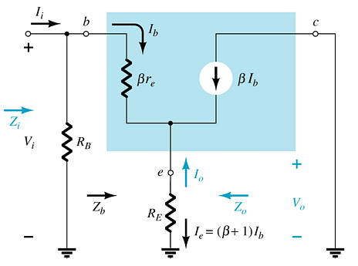
Emitter-Follower Configuration
This is also known as the common-collector configuration.
The input is applied to the base and the output is taken from the emitter.
There is no phase shift between input and output.

Slide 28
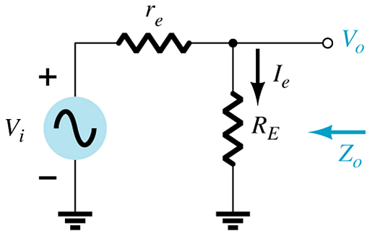
Impedance Calculations
Input impedance:
Output impedance:

Slide 29
Gain Calculations
Voltage gain:
Current gain:
Current gain from voltage gain:

Slide 30
Emitter-Follower Configuration
The important features of Emitter Follower are −
It has high input impedance
It has low output impedance
It is ideal circuit for impedance matching
To provide current amplification with no voltage gain.

